Slide 1
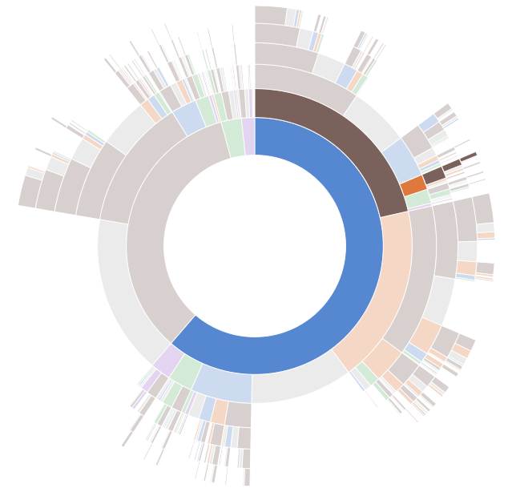

Data Driven Document
VISUALIZATION
FRAMEWORK
JAVASCRIPT
Presentation by :
Anil Kumar

Slide 2


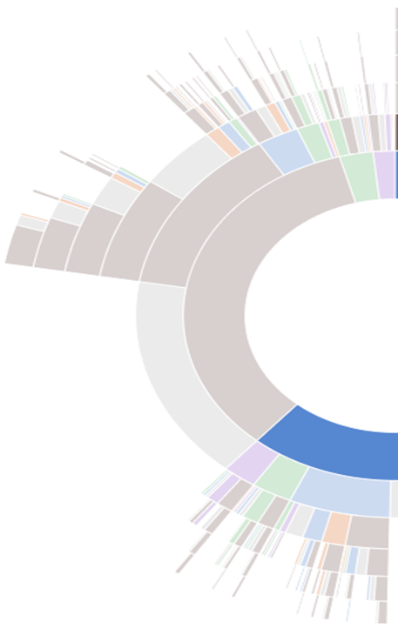
D3 Session Agenda
Introduction
Why D3
Type of Charts
Elements of D3
Environment Setup
Selection and Data Binding
SVG Chart
Scale
Axis
Transition
Drag & Zoom
Let us C working example
Resource
Data Driven Document

Slide 3
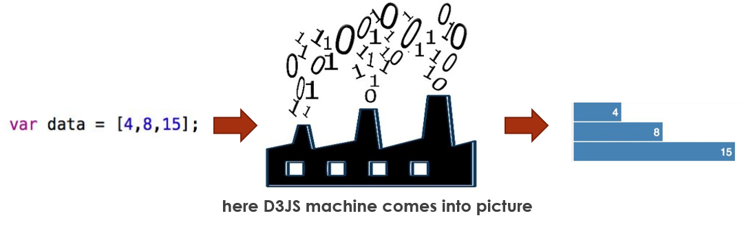
Introduction
D3.js is a JavaScript library for manipulating document based on data
DATA DRIVEN DOUCMENT
OR
Data Driven Document
Data are bound to DOM elements to make Data-Driven Documents

Slide 4
WHY d3
Challenges of Visualization
Versatile data and complex visualization.
Scalable data every day.
Interaction with data.
Data Driven Document
Overcomes with D3 or with other visualization framework
Visualize the data where visualization helps to understand.
Big data is kind of a thing.
Tell your story more easily.
Declarative and Data Bounding.
Manipulating data based SVGs.
Interactive interface with DOM.

Slide 5
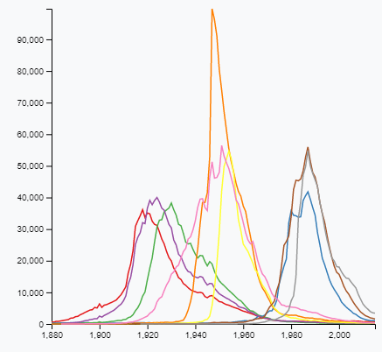
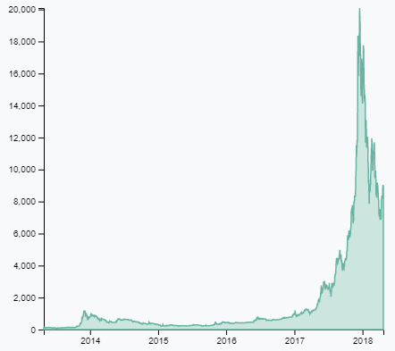
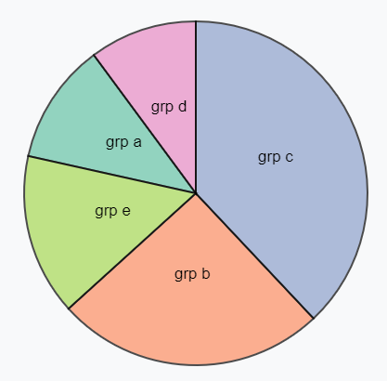
Type of charts
Data Driven Document
Look Into This
Line Chart
Area Chart
Pie Chart
JQuery

Slide 6
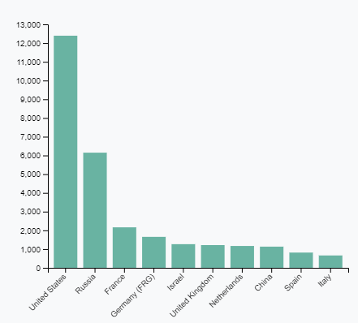
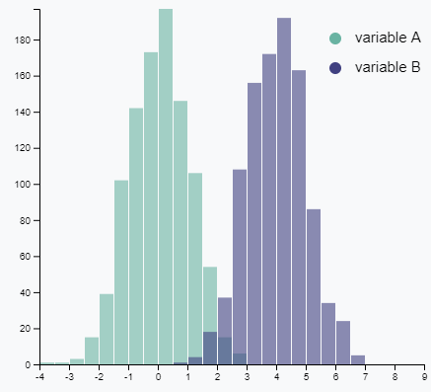
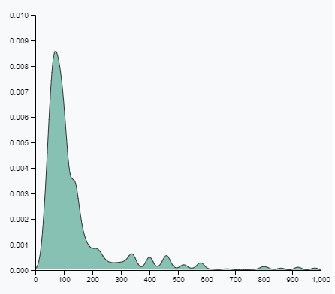
Type of charts
Data Driven Document
Look Into This
Bar Chart
Histogram Chart
Density Chart
JQuery

Slide 7
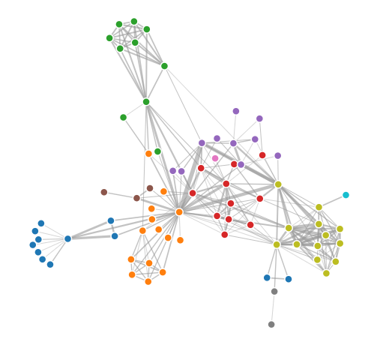
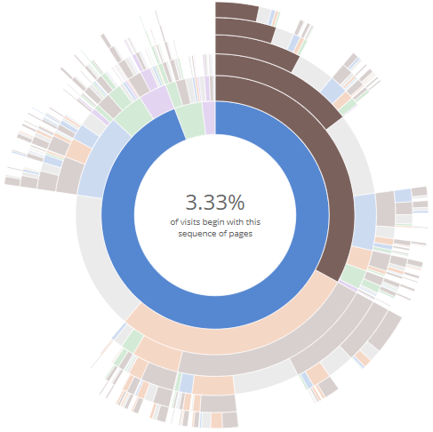
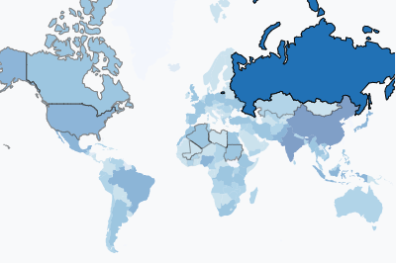
Type of charts
Data Driven Document
Look Into This
Network Chart
Choropleth Map
Sunburst Chart
JQuery

Slide 8
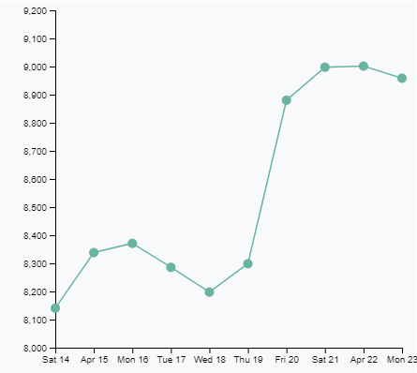
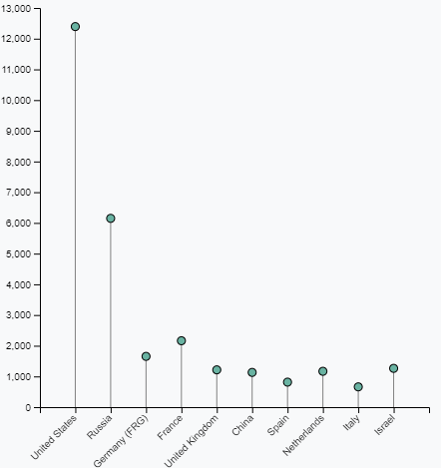
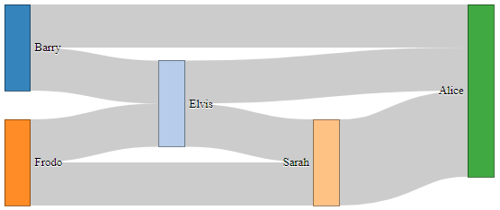
Type of charts
Data Driven Document
Look Into This
Scatter Plot
Lollipop Chart
Sankey Diagram
JQuery

Slide 9
Elements of D3
Hyper Text Markup Language.
Cascading Style Sheet.
JavaScript.
Scalable Vector Graph or Canvas.
Data Driven Document
JavaScript
JQuery

Slide 10
Environment setup
D3 v4+ supports all recent browser including IE 9+.
To use SVG and CSS3 Transitions your browser should support W3C standards.
Download D3 Library.
https://d3js.org/
Include D3 Library from CDN ( Content Delivery Network ).
<script src="https://d3js.org/d3.v4.min.js"></script>
D3 also runs with Node JS application.
cmd > npm install d3
var d3 = require("d3");
OR
import * as d3 from "d3";
Data Driven Document
JavaScript
JQuery

Slide 11
Section & Data binding
Selection is process of selection DOM elements and Binding refers to assigning some weightage to DOM elements.
Selection in d3 is almost similar to JQuery DOM section.
var paragraphs = document.getElementsByTagName("p");
for (var i = 0; i < paragraphs.length; i++) {
var paragraph = paragraphs.item(i);
paragraph.style.setProperty("color", "blue");
}
Data Driven Document
JavaScript
$("p").css(“color": “blue");
$(“.className").css(“color": “blue");
$(“#elementId").css(“color": “blue");
JQuery

Slide 12

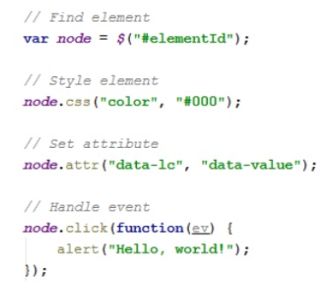
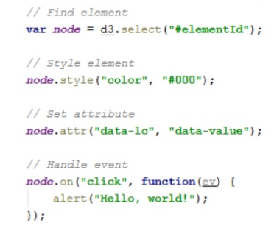
Section & Data binding
Data Driven Document
JavaScript
JQuery
D 3
JQuery

Slide 13
Section & Data binding
// Update…
var p = d3.select("body")
.selectAll("p")
.data([4, 8, 15, 16, 23, 42])
.text(function(d) {
return "I’m number " + d + "!";
});
// Enter…
p.enter().append("p")
.text(function(d) {
return "I’m number " + d + "!";
});
// Exit…
p.exit().remove();
Selecting
Let’s try this
select()
Select All()
Data Binding
datum()
data()
enter()
exit()
Data Driven Document
JavaScript
DOM Manipulation
append()
text(), html()
attr(), property()
style(), classed()
JQuery

Slide 14
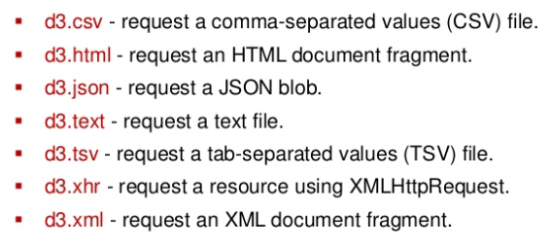
Section & Data binding
Supported external data file methods lists :
Data Driven Document
JavaScript
JQuery

Slide 15
S V G - Charts
What is SVG?
SVG stands for Scalable Vector Graphics.
SVG is used to define vector-based graphics for the Web.
SVG images can be created and edited with any text editor and also can be searched, indexed, scripted and compressed.
SVG graphics do NOT lose any quality if they are zoomed or resized
SVG files are pure XML and SVG is a W3C recommendation.
Data Driven Document
SVG provides different shapes like lines, rectangles, circles, ellipses etc.
Each SVG element has it's own properties, we provide geometry properties as attributes and styling properties as styles.
SVG sits in the DOM, we can use attr() and append() just like we did for HTML elements to add to HTML body.

Slide 16
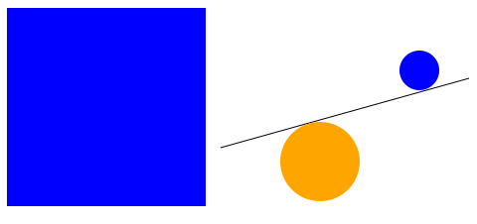
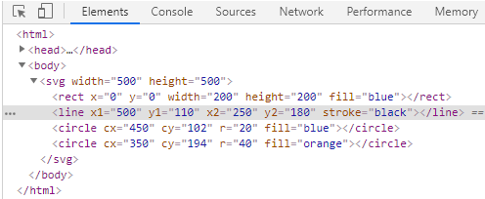
S V G - Charts
<svg width="500" height="500">
<rect x="0" y="0" width="200" height="200" fill="red" />
<line x1="500" y1="110" x2="250" y2="180" stroke="black" />
<circle cx="450" cy="102" r="20" fill="blue" />
<circle cx="350" cy="194" r="40" fill="orange" />
</svg>
Data Driven Document
var svg = d3.select("body")
.append("svg")
.attr("width", 500)
.attr("height", 500);
svg.append("line")
.attr("x1", 500)
.attr("x2", 250)
.attr("y1", 110)
.attr("y2", 180)
.attr("stroke", "black") ;
HTML SVG

Slide 17
Scales
Scales are functions that maps values from an input domain to output range, so that data can be visible in predefined screen size. It’s optional in d3.
0 ... 1
Domain
values
0 .............. 100000
Data Driven Document
0 ................ 100
Range
values
0 ... 100
var data = [100, 400, 300, 1000];
var scale = d3.scaleLinear()
.domain([d3.min(data), d3.max(data)])
.range([50, 500]);
g.append("rect")
.attr("width", d => scale(d))
.attr("height",barHeight-margin)
JQuery

Slide 18
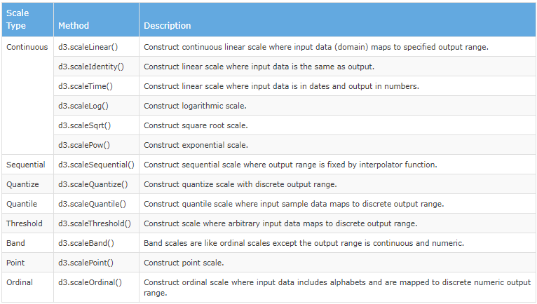
Scales
Data Driven Document
JQuery

Slide 19
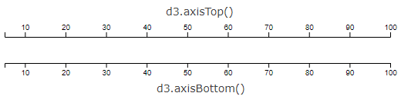
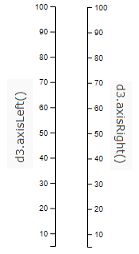
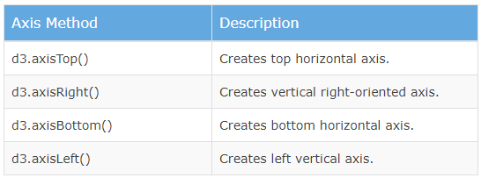
AxIs
Axis creates human readable reference mark for scaling or measuring objects on chart.
All axis are optional but scaling is required for axis.
Data Driven Document
JQuery

Slide 20
Transitions
Transition is special selection where operation applies smoothly over time period.
Transition is process of change from one state to another state of an object.
User eyes able to see the change in object model.
Data Driven Document
var body = d3.select("body")
.transition()
.duration(2000)
.style("background-color", "lightblue");
Look Into This
JQuery

Slide 21
Drag & zoom
Dragging and zooming are popular interaction techniques which let the user focus on a region of interest by restricting the view
var drag = d3.drag();
d3.select(".node")
.call(d3.drag()
.on("drag", function() {
});
Data Driven Document
Look Into This
var zoom = d3.zoom();
d3.select(".node")
.call(d3.drag()
.on(“mousedown.zoom", function() {
});
JQuery

Slide 22
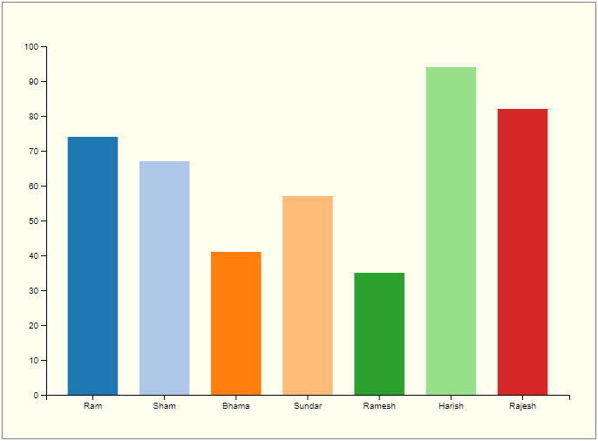
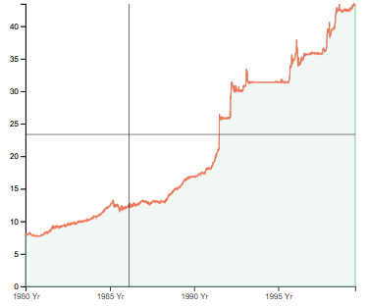
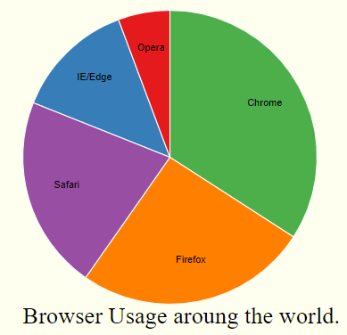
Let Us c Working examples
Data Driven Document
Look Into This
Student Mark List
Bar Chart
Currency Change USD -INR
Area Chart
Browser Usage Around World
Pie Chart
JQuery

Slide 23
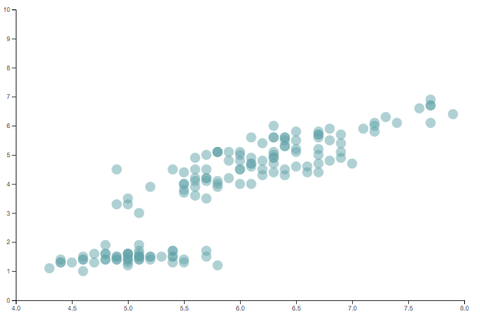
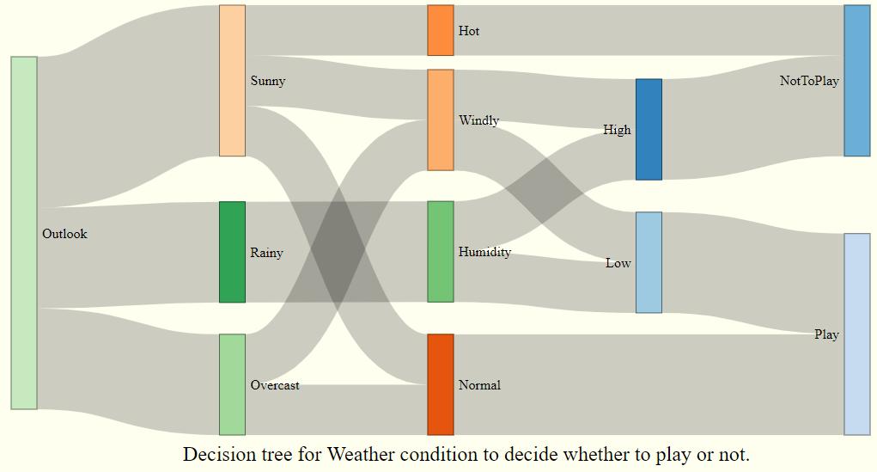
Let Us c Working examples
Data Driven Document
Look Into This
Drag & Zoom Effect
Decision Tree for Paying Sport
Sankey Diagram
http://bl.ocks.org/d3noob/5028304
JQuery

Slide 24
Resources - Further References
https://www.dashingd3js.com/svg-paths-and-d3js
https://www.tutorialspoint.com/d3js/index.htm
https://www.d3-graph-gallery.com/
https://www.tutorialsteacher.com/d3js
https://d3-wiki.readthedocs.io/zh_CN/master/Scales/
https://github.com/d3/d3-time-format
https://blog.bitsrc.io/11-javascript-charts-and-data-visualization-libraries-for-2018-f01a283a5727
https://www.d3-graph-gallery.com/graph/custom_axis.html
Data Driven Document

Slide 25

Data Driven Document
Thank You

